Slide 1
Certification program for Sites, Trainers and Testers in Jamaica
Presenter – Claudette Brown
Global Laboratory and Epidemiology Systems Strengthening Network (GLESSN)

Slide 2
INTRODUCTION
Jamaica is divided into 4 Health Regions namely, the Western, Southern, South Eastern and North Eastern Regional Health Authorities.
RTCQI piloted at 12 sites recommended by MOH in May 2015
51 active HIV testing sites across all Regions. Currently, twenty–six (26) are supported by PEPFAR.
RTCQI sites are increased in Regions upon request to CDC
Sites include hospital laboratories, health centres, antenatal clinics, Non-Governmental Organizations and treatment centres.

Slide 4
Certification Process
Certification is in its developmental stage in Jamaica. GLESSN has been collaborating with the MOHW to develop the framework for the certification programme. This include establishment of:
Criteria (Policies and procedures) for site certification, re-certification and de-certification
Criteria (Policies and procedures) for trainer and tester certification, re-certification and de-certification
Governing committee for a sustainable monitoring and evaluation programme (include personnel from the Reference Lab and the MOHW)
Database management system (gathering, analysis & reporting)

Slide 5
SITE CERTIFICATION PLAN…..1/2
Site Certification Programmes are an effective way to ensure compliance with standards and quality improvement processes are continually implemented in sites
Assessments conducted twice annually by GLESSN staff using the Stepwise Process for Improving the Quality of Recency and HIV Rapid Testing (SPI-RRT) Checklist.
Q-Corps implement various quality improvement activities via use of tools, e.g., job aids, SOPs, etc.
Q-Corps are usually Regional Medical Technologists or Senior laboratory supervisors who are RTCQI-trained.
Sites obtaining a Level 4 status for 2 consecutive assessments will be recognized for certification.

Slide 6
SITE CERTIFICATION PLAN…..2/2
Assessments are conducted for new sites to get baseline data.
Over the years we have had up to 70% of the sites at level 4
60% sites consistently at Level 4
40% sites currently at Level 3
Level 0 | Less than 40%
Level 1 | 40% - 59%
Level 2 | 60%-79%
Level 3 | 80%-89% (near certification)
Level 4 | 90% or higher (Certification level)

Slide 7
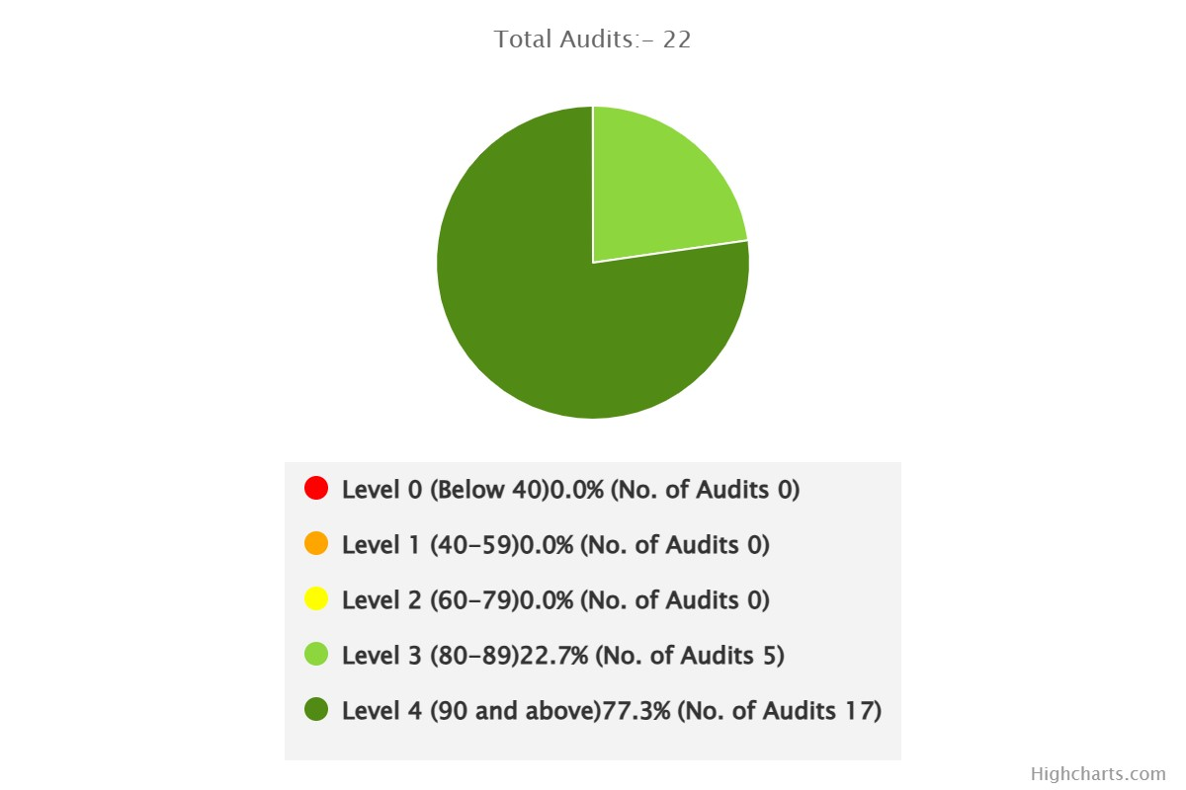
RTCQI sites levels attained across Regions using the SPI-RT checklist 3.1 (Feb 2022), SPI-RT Checklist 4.0 (May 2022 to June 2022) and SPI-RRT Checklist 6.0 (Aug 2022- Feb 2024).
RTCQI sites levels attained across Regions for the period October 2023 to February 2024 – 22 Sites assessed
LEVELS | Feb 2022 | May/Jun 2022 | Aug/Sept 2022 | Nov/Dec 2022 | Aug/Sept 2023 | Oct 2023 /Feb 2024
Level 4 ≥90% | 81% | 75% | 75% | 78% | 67% | 77%
Level 3 80-89% | 19% | 25% | 25% | 11% | 26% | 23%
Level 2 60-79% | 0% | 0% | 0% | 11% | 7% | 0%
Level 1 40-59% | 0% | 0% | 0% | 0% | 0% | 0%

Slide 8
Regional Performance by Percentage from February 2022 to February 2024.

Slide 9
SITE DE-CERTIFICATION PLAN
National Quality Assurance Coordinator :
Must have two successive Level 4 results to maintain certification.
Will issue a warning after the first failure
Will be de-certified after two successive failed attempts to achieve Level 4 at the assessments

Slide 10
TRAINER CERTIFICATION PLAN……1/3
GLESSN has continued to support the Rapid HIV and Syphilis testing programme by facilitating a Training of Trainers (ToT) workshop in 2023 where 17 staff from the 4 Regions participated.
The protocol for trainer certification includes that the trainer should have:
100% attendance at the workshop
a passing score of 90% for written examination

Slide 11
TRAINER CERTIFICATION PLAN….2/3
a passing score of 100% for practical examination
successful participation in teach back sessions supervised by
personnel from the MOHW. (Direct observation by assessors
and observers).
3 trainers already successfully conducted teach back sessions.
14 more trainers to participate in teach back sessions

Slide 12
TRAINER CERTIFICATION PLAN….3/3
Successful trainers will be added to the national database
Trainer Certificates to be issued by the MOHW
Certificate as trainer will be valid for three (3) years
Trainers will be eligible for re-certification after successful
participation in a current ToT workshop.
The lead person in the Certification programme is the
National Quality Assurance Coordinator.

Slide 13
TESTER CERTIFICATION PLAN
There are approximately one hundred and fifteen (115) testers across the Regions.
Testers are eligible for certification after receiving comprehensive training on Rapid HIV and Syphilis testing, using the nationally approved curriculum.
The curriculum covers nine(9) modules
Practical training covers Rapid HIV and Syphilis Testing
Testers are required to demonstrate competency in all tests.
They must receive a grade of 75% or above on the written test and 100% on the practical.

Slide 14
TESTER CERTIFICATION PLAN
Successful trainees/testers participating at the teach back sessions will also be eligible for certification.
After two (2) years, testers are required to participate successfully in a Rapid HIV and Syphilis testing training for re - certification
Successful trainees/testers are also to be added to the database

Slide 15
GLESSN SUPPORT
Provides refresher training for testers. These trainings include:
Use of HIV logbook
Safety practices
Quality control procedures
Inventory management
Proficiency testing
Corrective Actions

Slide 16
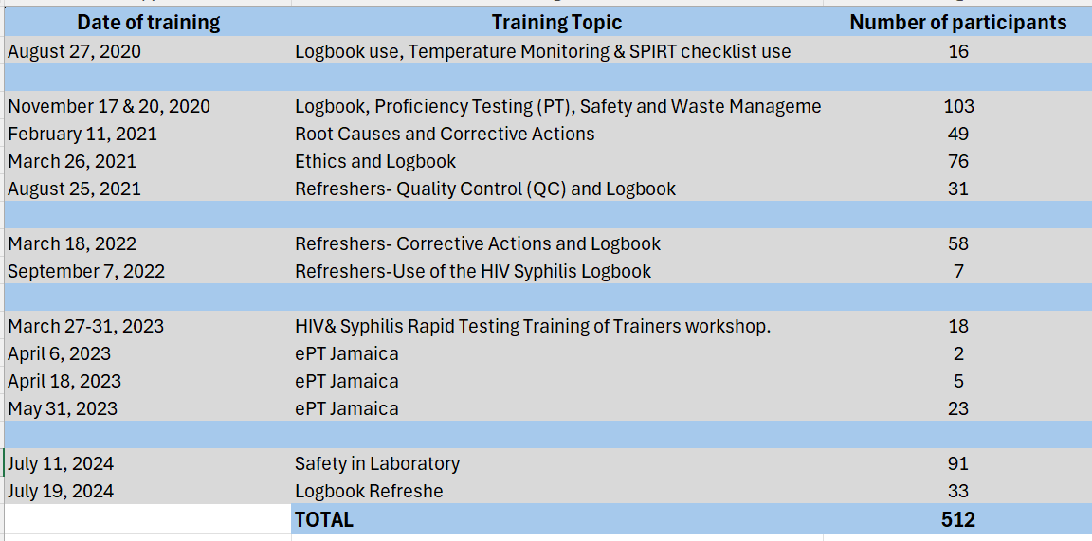
Trainings conducted 2020 -2024

Slide 17
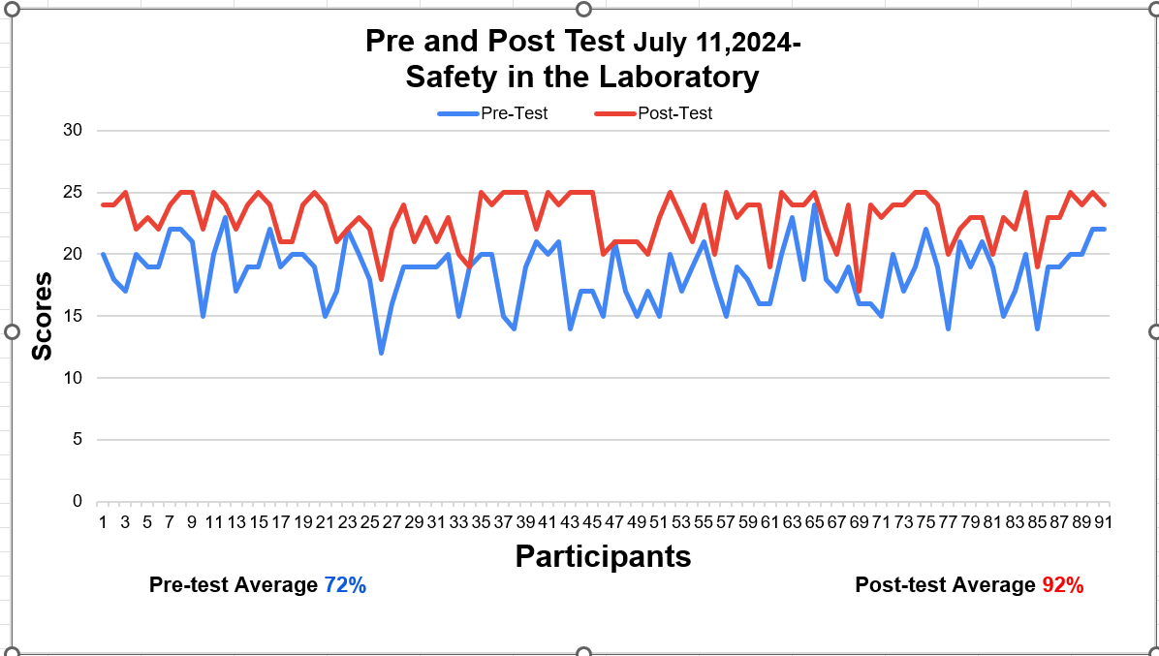
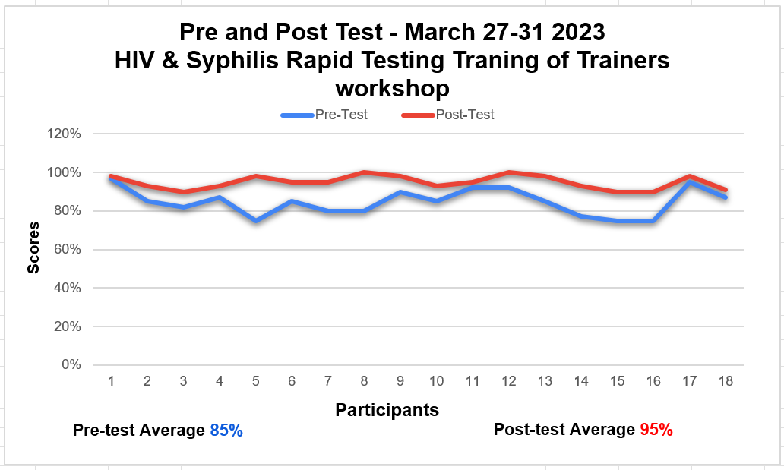
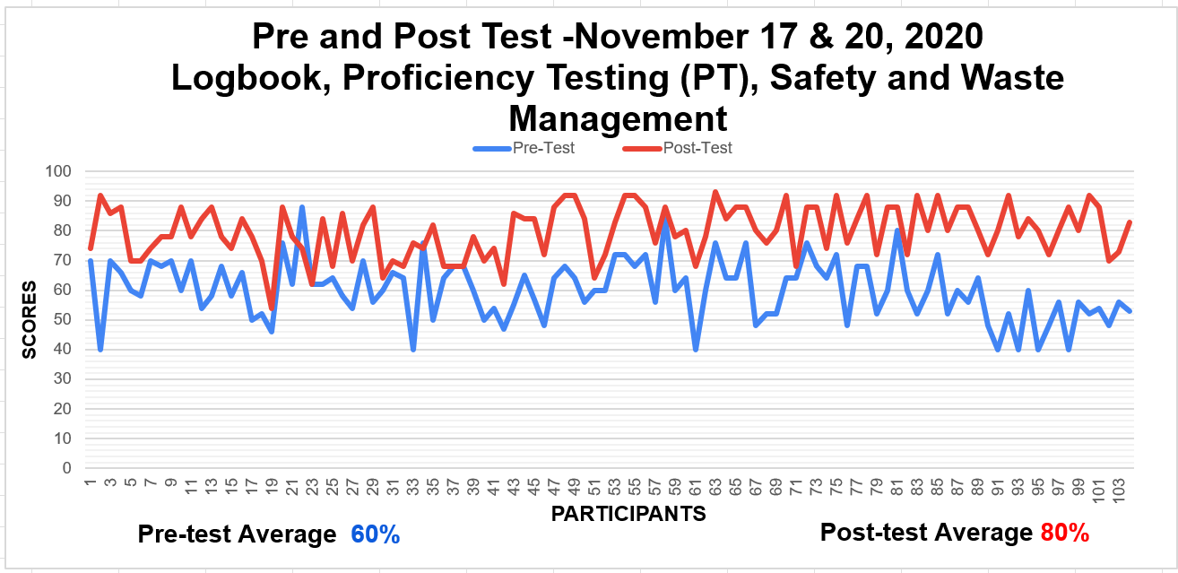
Training Programs Pre and Post Test Result

Slide 18
GLESSN SUPPORT
Ensures that assessments are conducted according to protocol and generates report for submission to the MOHW.
Conducts follow up visits and assists with corrective actions
Facilitates ToT workshops and teach back sessions
Assists with procurement of HIV logbooks, safety supplies and small equipment e.g., pipettes, thermometers and timers
Conducts training sessions to assist sites with implementation of improvement programmes.

